Slide 1
SOFTWARE QUALITY METRICS

Slide 2
ROADMAP
Introduce the necessity for software metrics
Differentiate between process, project and product metrics
Quality Control and tools.
Managing Variations using Statistical Process controls.
Causal Analysis and Defect Prevention.

Slide 3
WHAT ARE SOFTWARE METRICS?
Any type of measurement which relates to a software system, process or related documentation.
  Lines of code in a program
  Number of person-days required to implement a use-case
  Number of Defects

Slide 4
TERMINOLOGY
Measure: Quantitative indication of the extent, amount, dimension, or size of some attribute of a product or process. A single data point
Metrics: The degree to which a system, component, or process possesses a given attribute. Relates several measures (e.g. average number of errors found per person hour)
Indicators: A combination of metrics that provides insight into the software process, project or product
Direct Metrics: Immediately measurable attributes (e.g. line of code, execution speed, defects reported)
Indirect Metrics: Aspects that are not immediately quantifiable (e.g. functionality, quantity, reliability)
Faults:
  Errors: Faults found by the practitioners during software development
  Defects: Faults found by the customers after release

Slide 5
PROCESS, PRODUCT & PROJECT METRICS
Process - Focus on quality achieved as a consequence of a repeatable or managed process. Strategic and Long Term.
Project - Used by Project manager and software team to adapt project work flow and technical activities. Tactical and Short Term.
  Minimize the development schedule by making the necessary adjustments to avoid delays and mitigate problems
  Assess product quality on an ongoing basis
Product - Focus on the quality of deliverables
  Product metrics are combined across several projects to produce process metrics
    Complexity of the Design Model
    Architectural complexity
    Data flow complexity

Slide 6
QUALITY CONTROL
Quality control (QC) is a procedure or set of procedures intended to ensure that a service performed or a product developed adheres to a defined set of quality criteria or meets the customer requirements.
"As much as 95% of quality related problems in the factory can be solved with seven fundamental quantitative tools."
Basic 7 QC Tools
  Pareto Chart
  Cause and Effect Diagram
  Histograms
  Flow charts
  Scatter Diagram
  Check Sheets
  Control Charts

Slide 7
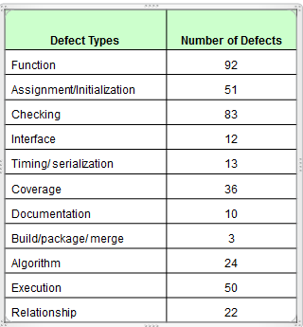
PARETO CHART
A type of Chart which contains both bars and a line graph
  Individual values are represented in descending order by bars
  Cumulative total is represented by the line
Used to highlight the most important among a set o factors.
Minitab Example
Draw a Pareto Chart for the given pre-delivery defect data for one year. As a project manager, which defect types will you monitor first for controlling defects in the project?

Slide 8
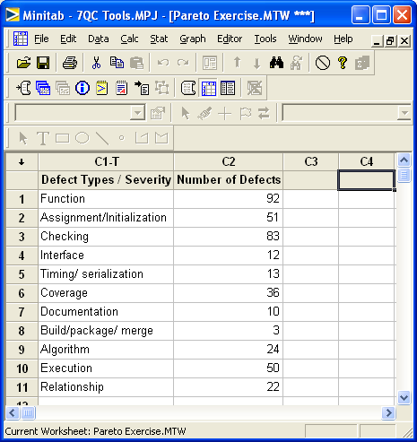
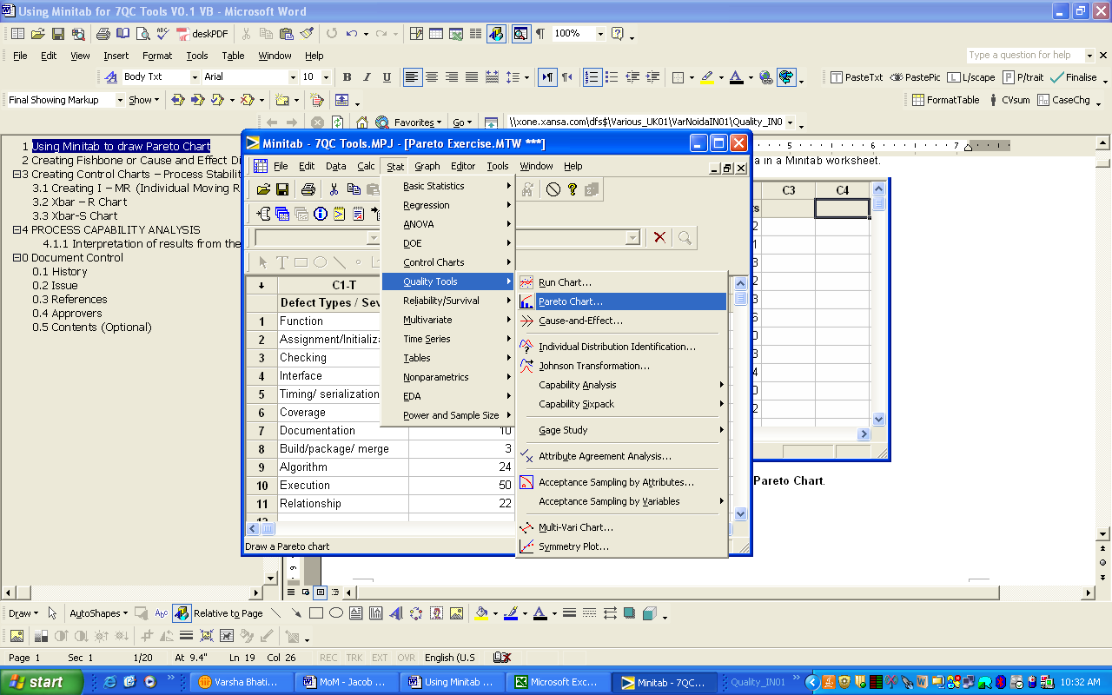
PARETO CHART – MINITAB EXAMPLE
First enter the values in Minitab as below and select Stat – Quality Tools – Pareto Chart

Slide 9
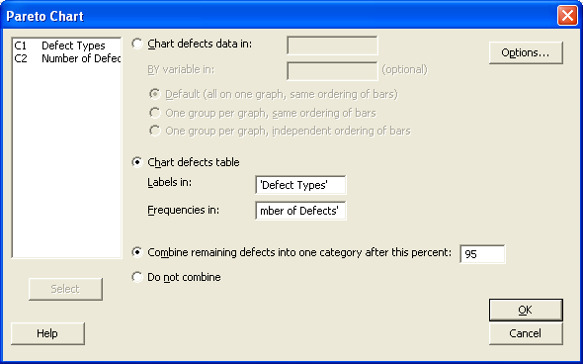
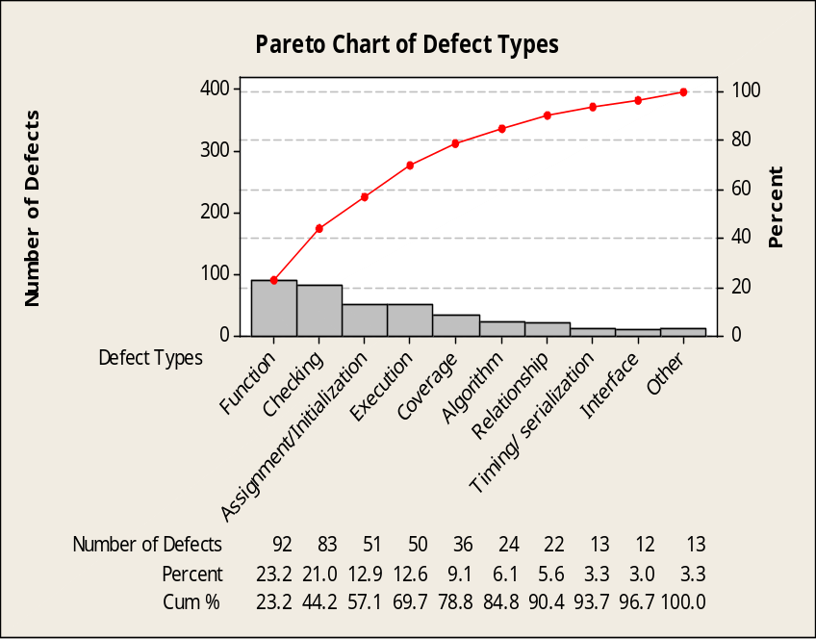
PARETO – MINITAB EXAMPLE..
Select the Radio Button for Chart defects table. Substitute the references to the following column values in the Chart defects table.
Click OK. The following Pareto Chart will be displayed.

Slide 10
CAUSE AND EFFECT DIAGRAM
Diagrams that show the causes of a certain event.
Used commonly for defect prevention
Causes are usually grouped into major categories and include:
  Man, Machines, Methods, Materials, Measurements, Environment
A project team observes frequent Computer down time that was impacting the output of the team. A meeting was called to understand the potential causes of this problem and after a brainstorming session, following causes were identified. Draw a Cause and Effect Diagram for this problem.
Causes - Software | Causes - Hardware | Causes - Environment | Causes - User | Sub Cause - Skills
Faulty Design | Faulty Component | Corrosion | Skills | Experience
Faulty Installation | Component Failure | Mechanical Shock | Abuse of HW | Lack of Training
Faulty Media | Power Fluctuation | Temperature | Misuse of HW
Inadequate Documentation | Inadequate Power | Humidity | Misapplication of Software

Slide 11
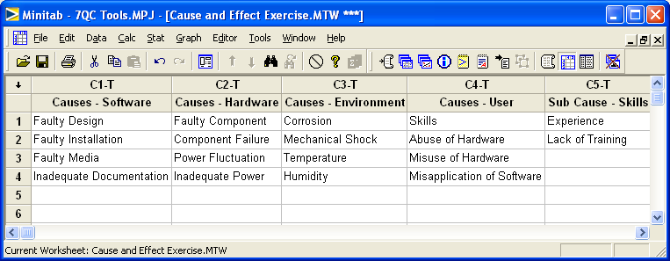
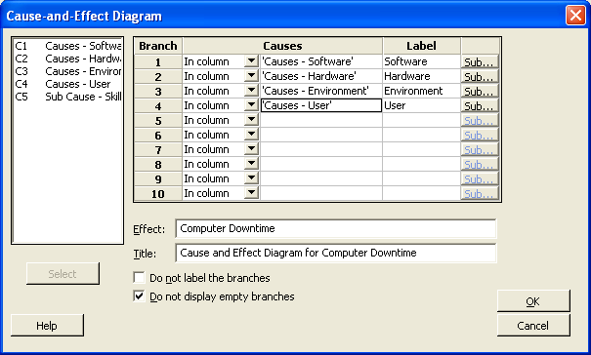
CAUSE AND EFFECT DIAGRAM..
select Stat -> Quality Tools -> Cause-and-Effect
In the screen that appears, enter the values as show in the following figure.

Slide 12
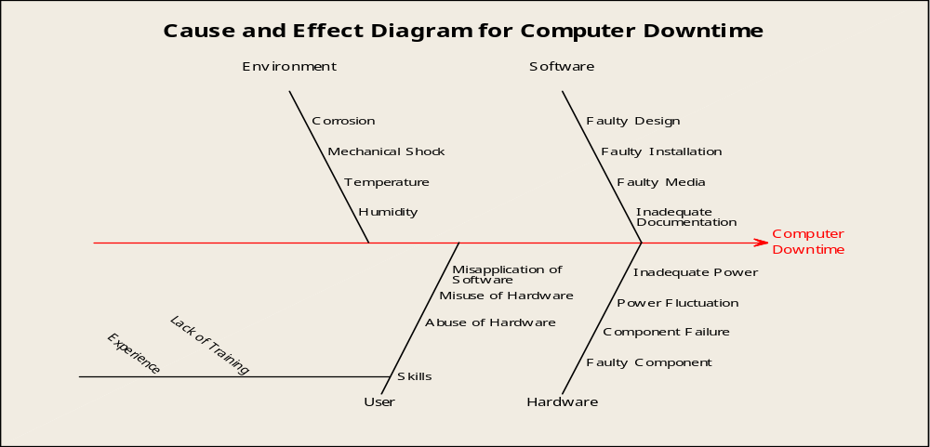
CAUSE AND EFFECT DIAGRAM..
To create sub-branches, click on the button labelled Sub and against the Label Skills, enter the value as shown in the following screen and click OK to get the diagram.

Slide 13
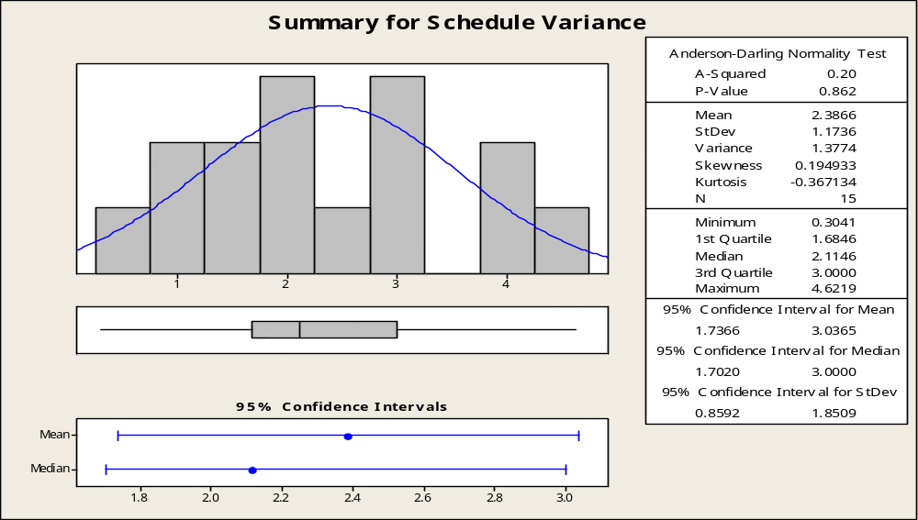
HISTOGRAMS
Histogram is a graphical display of tabular frequencies, shown as adjacent rectangles.
The total area of histogram is equal to the number of data.

Slide 14
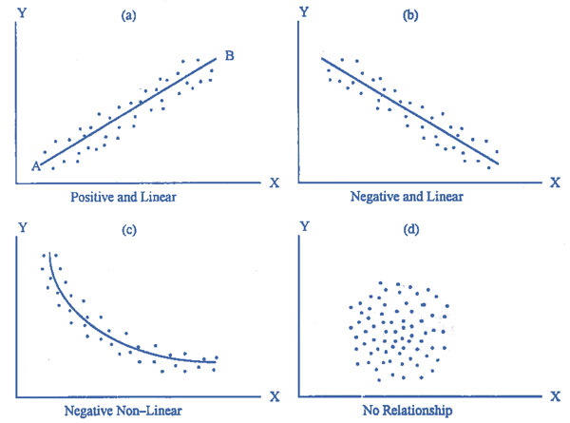
FLOWCHARTS, SCATTER DIAGRAM
Flowcharts - Used in analyzing, designing, documenting or managing a process.
Scatter Diagram
  A tool used for analyzing relationships between two variables.
  Pattern of their intersecting points can graphically show relationship patterns.

Slide 15
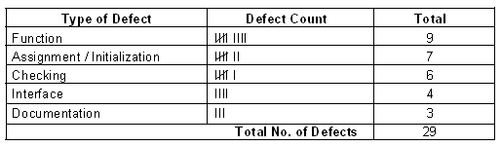
CHECK SHEETS
Simple document used for collecting data in real-time.
They are helpful in organizing data by category especially as more data are collected.
Mostly used in registering the frequency of incidents that are believed to cause problems.

Slide 16
CONTROL CHARTS
A tool used to determine whether or not a business process is in-control or out-of-control.
Consists of the following:
  Plotted points, which represent individual observations for the quality characteristic of interest.
  Center line, average line of the plotted data points
  Control limits, which are set at a distance of 3 sigma above and below the center line
UCL : Upper Control Limit
LCL : Lower Control Limit

Slide 17
STATISTICAL PROCESS CONTROL
S.P.C. is the statistical analysis of stability, capability and predictability of a process to give a consistent output.
Process Variations
No process or tool is able to produce consecutive outputs which are identical in performance.
The differences may be large or very small, but they are always there.
The differences are known as ‘variation’. This is the reason why ‘tolerances’ are used.

Slide 18
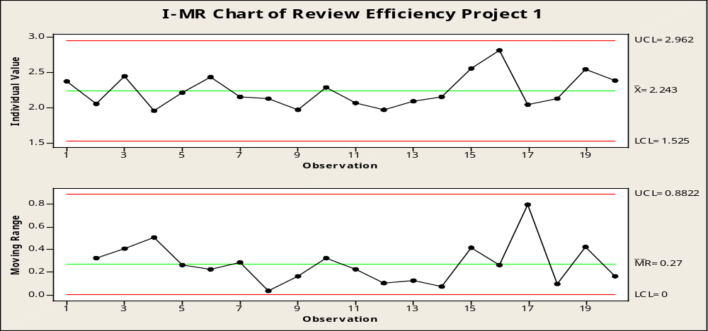
I - MR CHART
It’s a variable chart to monitorsthe mean and the variation of the process.
Since all the data gathered from various accounts are individual data and are not based on sub-groups, we prefer using I-MR chart.
All data points lie within the limits. Signifies a stable process

Slide 19
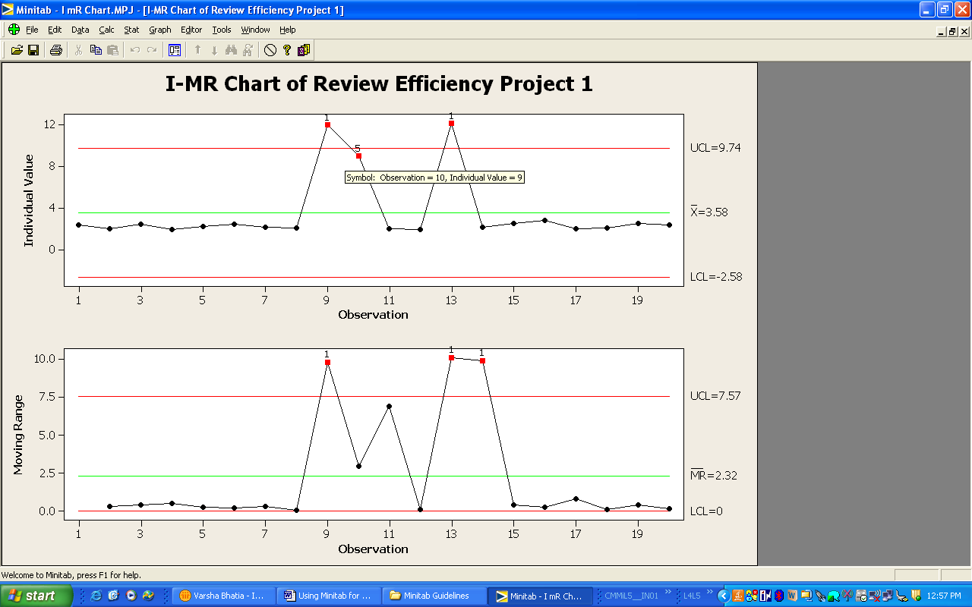
I - MR CHART….
Denotes variability or instability in process and requires analysis

Slide 20
CAUSAL ANALYSIS AND DEFECT PREVENTION
Identify and prioritize the commonly occurring defects/problems and take preventive action.
Identify the root causes for defects and prevent their recurrence.
Implement and track the preventive measures and review their effectiveness
Track the institutionalisation and effectiveness of CAR activities across organisation.
The Organisation Level Causal analysis activities are to be performed by the EPG Team.

Slide 21
Thanks
&
All the Best

